Slide 1
JOINS

Slide 2
SQL JOINS
What is SQL Join?
❖ JOIN clause combines rows from two or more tables. ❖ creates a set of rows in a temporary table.
Types of SQL JOIN
EQUI JOIN
EQUI JOIN is a simple SQL join.
Uses the equal sign(=) as the comparison operator for the condition
NON EQUI JOIN
NON EQUI JOIN uses comparison operator other than the equal sign.
The operators uses like >, <, >=, <= with the condition.

Slide 4
Types of SQL EQUI JOIN
INNER JOIN
Returns only matched rows from the participating tables.
Match happened only at the key record of participating tables.
OUTER JOIN
Returns all rows from one table and
Matching rows from the secondary table and
Comparison columns should be equal in both the tables.

Slide 5
List of SQL JOINS
INNER JOIN
LEFT JOIN OR LEFT OUTER JOIN
RIGHT JOIN OR RIGHT OUTER JOIN
FULL OUTER JOIN
CROSS JOIN
SELF JOIN

Slide 7
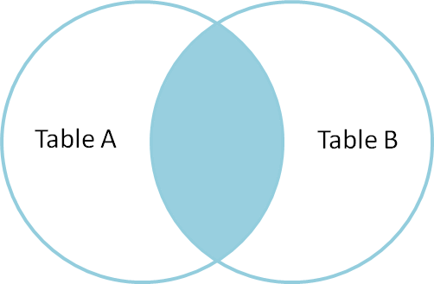
INNER JOIN
The INNER JOIN selects all rows from both participating tables as long as there is a match between the columns. An SQL INNER JOIN is same as JOIN clause, combining rows from two or more tables.
Example: INNER JOIN
SELECT * FROM table_A INNER JOIN table_B ON table_A.A=table_B.A;

Slide 8
SYNTAX
SELECT table1.column1,table1.column2,table2.column1,....
FROM table1
INNER JOIN table2
ON table1.matching_column = table2.matching_column;
table1: First table.
table2: Second table
matching_column: Column common to both the tables.

Slide 9
queries
select * from student INNER JOIN hostel ON STUDENT.STUDENT_ID=HOSTEL.Reg_no;
select student.student_id,student.s_name,hostel.hostel_name,hostel.room_no from STUDENT INNER JOIN HOSTEL ON student.student_id= hostel.reg_no;
select s.student_id,s.s_name,h.hostel_name,h.room_no from STUDENT as S INNER JOIN HOSTEL as H ON s.student_id= h.reg_no;

Slide 11
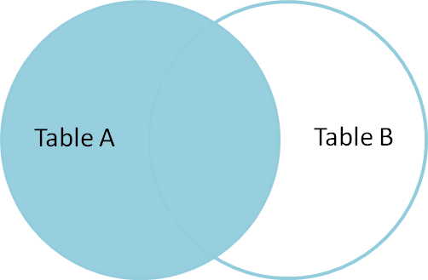
LEFT JOIN or LEFT OUTER JOIN
The SQL LEFT JOIN, joins two tables and fetches rows based on a condition, which are matching in both the tables. The unmatched rows will also be available from the table before the JOIN clause.
returns all rows from the left table, even if there are no matches in the right table.
Example: LEFT JOIN or LEFT OUTER JOIN
SELECT * FROM table_A LEFT JOIN table_B ON table_A.A=table_B.A;

Slide 12
SELECT table1.column1,table1.column2,table2.column1,....
FROM table1
LEFT JOIN table2
ON table1.matching_column = table2.matching_column;
table1: First table.
table2: Second table
matching_column: Column common to both the tables.

Slide 13
queries
SELECT * FROM StudInfo AS S LEFT JOIN Hostel AS H ON S.STUDENT_ID=H.H_id;

Slide 15
RIGHT JOIN or RIGHT OUTER JOIN
The SQL RIGHT JOIN, joins two tables and fetches rows based on a condition, which are matching in both the tables. The unmatched rows will also be available from the table written after the JOIN clause.
Example : RIGHT JOIN or RIGHT OUTER JOIN
SELECT * FROM table_A RIGHT JOIN table_B ON table_A.A=table_B.A;

Slide 16
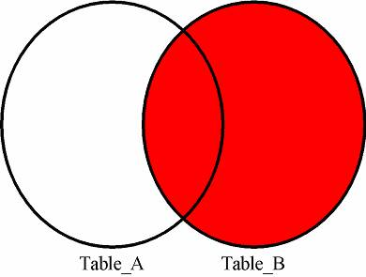
SELECT table1.column1,table1.column2,table2.column1,....
FROM table1
RIGHT JOIN table2
ON table1.matching_column = table2.matching_column;
table1: First table.
table2: Second table
matching_column: Column common to both the tables.

Slide 17
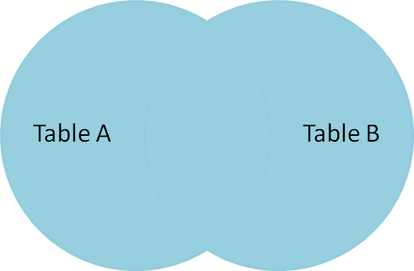
FULL JOIN:
FULL JOIN: FULL JOIN creates the result-set by combining result of both LEFT JOIN and RIGHT JOIN. The result-set will contain all the rows from both the tables. The rows for which there is no matching, the result-set will contain NULL values.Syntax:

Slide 18
SELECT table1.column1,table1.column2,table2.column1,....
FROM table1
FULL JOIN table2
ON table1.matching_column = table2.matching_column;
table1: First table.
table2: Second table
matching_column: Column common to both the tables.

Slide 19
Self join
The SQL SELF JOIN is used to join a table to itself as if the table were two tables; temporarily renaming at least one table in the SQL statement.
SELECT a.column_name, b.column_name...
FROM table1 a, table1 b
WHERE a.common_field = b.common_field;

Slide 20
Customer(Cust_Id,Cust_Name,City,City_Pin,Gender,Age,Country,Grade,Salesman_Id)
Salesman(Salesman_Id,Sales_man_Name,City,Commission)

Slide 21
Write a SQL statement to prepare a list with salesman name, customer name and their cities for the salesmen and customer who belongs to the same city.
SELECT Sales_man_Name,Salesman.City,Cust_Name,Customer.City FROM Customer, Salesman WHERE Customer.City = Salesman.City;

Slide 22
Write a SQL statement to know which salesman are working for which customer.
SELECT Salesman.Sales_man_Name,Customer.Cust_Name FROM Salesman INNER JOIN Customer ON Customer.Salesman_Id = Salesman.Salesman_Id;

Slide 23
Write a SQL statement to find the list of customers who appointed a salesman for their jobs who gets a commission from the company is more than 12%.
SELECT a.cust_name AS "Customer Name", a.city, b.name AS "Salesman", b.commission FROM customer a INNER JOIN salesman b ON a.salesman_id=b.salesman_id WHERE b.commission>.12;

